Slide 1

Chapter 1
An Overview of U.S. Health Care Delivery

Slide 2
Learning Objectives
Understand the nature of the U.S. health care system.
Outline the key functional components of a health care delivery system.
Get a basic overview of the Affordable Care Act.
Discuss characteristics of the U.S. health care system.
Emphasize importance for practitioners and managers to understand the health care delivery system.
Get an overview of health care systems in selected countries.
Point out global health challenges and reform efforts.
Introduce the systems model as a framework.

Slide 3
Introduction
The U.S. has a unique health care delivery system.
Americans are not automatically covered.
A true system does not exist.
The health care system is fragmented.
It continues to undergo periodic changes.

Slide 4
Overview of the Scope and Size of the System
The health care workforce employs over 16.4 million people.
838,000 active MDs
70,480 DOs
2.6 million nurses
5,795 hospitals
15,700 nursing homes
1,375 health centers
180 medical and osteopathic schools
1,500+ nursing programs

Slide 5
A Broad Description of the System (1 of 4)
Characteristics of the U.S. system
Multiplicity of financial arrangements
Numerous insurance agencies/MCOs that employ various mechanisms for insuring against risk
Multiple payers that make their own determinations about the cost for each service
Diverse settings where services are delivered
Numerous consulting firms offering expertise in planning, cost containment, electronic systems, quality, and restructuring of resources

Slide 6
A Broad Description of the System (2 of 4)
Little standardization, missing dimensions in system
Planning
Direction
Coordination from a central agency
Inefficiencies created
Duplication
Overlap
Inadequacy
Inconsistency
Waste

Slide 7
A Broad Description of the System (3 of 4)
Cost control
Financial manipulation
Two primary objectives
Enable all citizens to obtain needed health care services
Ensure cost-effective services and meet quality standards

Slide 8
A Broad Description of the System (4 of 4)
Leads the world in
Medical technology
Medical training
Research
Sophisticated institutions, products, and processes

Slide 9
Financing and Insurance Mechanisms
Employer-based health insurance (private)
Privately purchased health insurance (private)
Government programs (public)
State Employees Group
Employees
Medicare
Elderly and certain disabled people
Medicaid and CHIP
Indigent, poor (if meet eligibility criteria), children

Slide 10
Insurance and Health Care Reform
Medicare, Medicaid, and Children’s Health Insurance Program (CHIP)
Reasons employment-based system left some uninsured
Small businesses cannot get group insurance at affordable rates and are unable to offer insurance.
Participation in insurance programs may be voluntary.
Affordable Care Act
Required all U.S. citizens and legal residents to be covered by public or private insurance

Slide 11
Major Characteristics of the U.S. Health Care System
Political climate
Economic development
Technological progress
Social and cultural values
Physical environment
Population characteristics (demographics, health trends)
Global influences

Slide 12
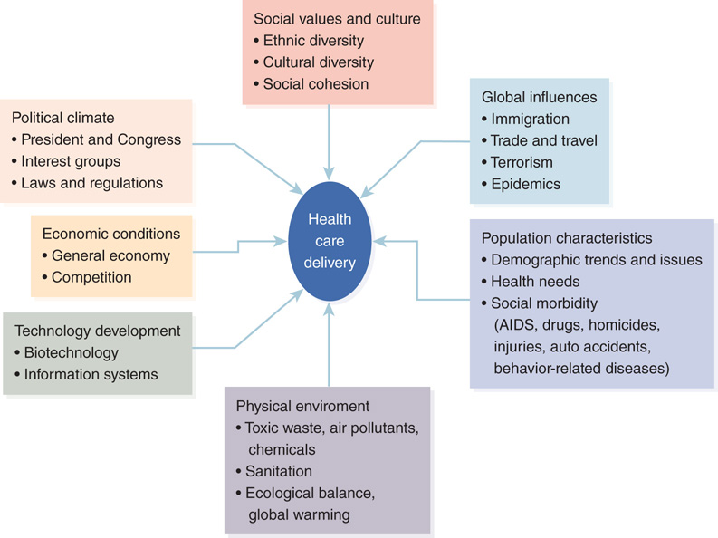
Figure 1-2: External forces affecting health care delivery.

Slide 13
Ten Basic Characteristics Differentiate the U.S. Health Care Delivery System (1 of 2)
No central agency governs the system.
Access to health care services is selectively based on insurance coverage.
Health care is delivered under imperfect market conditions.
Third-party insurers act as intermediaries between the financing and delivery functions.
The existence of multiple payers makes the system cumbersome.

Slide 14
Ten Basic Characteristics Differentiate the U.S. Health Care Delivery System (2 of 2)
The balance of power among players prevents any single entity from dominating the system.
Legal risks influence practice behavior of physicians.
Development of new technology creates an automatic demand for its use.
New service settings have evolved along a continuum.
Quality is not accepted as an unachievable goal.

Slide 15
1. No Central Agency (1 of 2)
Most developed nations have national health care.
To control costs, use global budget to determine total health care expenses.
Government controls proliferation of health services.
U.S. has mostly private financing and delivery.
Financing via employers 52% and government 48%.
Private health care, hospitals, and physicians are independent of government.

Slide 16
1. No Central Agency (2 of 2)
No one monitors total expenses through global budgets and utilization.
U.S. determines public-sector expenses and reimbursement rates for Medicare/Medicaid/CHIP.
Government sets standards of participation.
Providers must comply with standards to be certified to provide care for Medicaid and Medicare patients.
Regarded as minimum standards of quality.

Slide 17
2. Partial Access (1 of 2)
Access is the ability to obtain health care when needed.
Americans can access health care services
Through their employers
Under a government health care program
By buying insurance using private funds
By paying for services privately
By obtaining charity or subsidized care
Health insurance helps ensure access.

Slide 18
2. Partial Access (2 of 2)
Uninsured Americans
Able to obtain medical care for acute illness
Form of universal catastrophic health insurance
Usually forego basic and routine care
Universal access
Countries with national health care programs provide universal coverage.
The ability of all citizens to obtain health care when needed is mostly a theoretical concept.

Slide 19
3. Imperfect Market (1 of 3)
The U.S. has a quasi-market where health care is partially managed by free markets.
In a free market, multiple patients and providers act independently.
Providers do not collude to fix prices.
Prices are set by the interaction of supply and demand.
Inverse relationship between quantity of services demanded and price of services.
Equilibrium is achieved without interference.

Slide 20
3. Imperfect Market (2 of 3)
Unrestrained competition.
Patients must have information about the availability of different services.
Consumers are seizing some measure of control.
Internet as a source of medical information.
Patients must bear cost of services received.
Moral hazard.

Slide 21
3. Imperfect Market (3 of 3)
Two factors limit patients’ decisions:
Need
Demand
Item-based pricing
Fees charged for service (surgeon’s price)
Phantom providers
Bill for services separately
Package pricing
Bundled fee for a group of related services

Slide 22
4. Third-Party Insurers and Payers
Patient is first party.
Provider is second party.
Intermediary is third party.
A wall of separation between financing and delivery.
Quality of care is a secondary concern.

Slide 23
5. Multiple Payers (1 of 2)
Single-payer system.
A national health care system that is usually the primary payer, the government
The United States has many payers; company can choose different plans.
A billing and collection nightmare

Slide 24
5. Multiple Payers (2 of 2)
System becomes more cumbersome.
Difficult for providers to track various health plans.
Providers must hire claims processors.
Payments can be denied for not following requirements, which necessitates rebilling.
Some plans allow providers to balance bill whereas others do not.
Providers must engage in collection efforts.
Government programs have complex regulations.

Slide 25
6. Power Balancing
Multiple players
Key players
Physicians, administrators, insurance companies, large employers, and the government.
Have own economic interests to protect.
Self-interests are often at odds.

Slide 26
7. Litigation Risks
The United States is a litigious society.
Private health care providers are increasingly susceptible.
Risk of malpractice lawsuits.
Practitioners engage in defensive medicine.
Prescribe diagnostic tests, return checkups, documentation
Notes:
Information updated

Slide 27
8. High Technology
The U.S. is a hotbed of research and innovation in new technology.
Creates demand for new services despite high costs
With capital investments, must have utilization
Legal risks for providers denying new technology
Notes:
Information updated

Slide 28
9. Continuum of Services
Three categories of medical care services:
Curative
Restorative
Preventative
Health care is not confined to the hospital.
Additional settings.
Notes:
Information updated

Slide 29
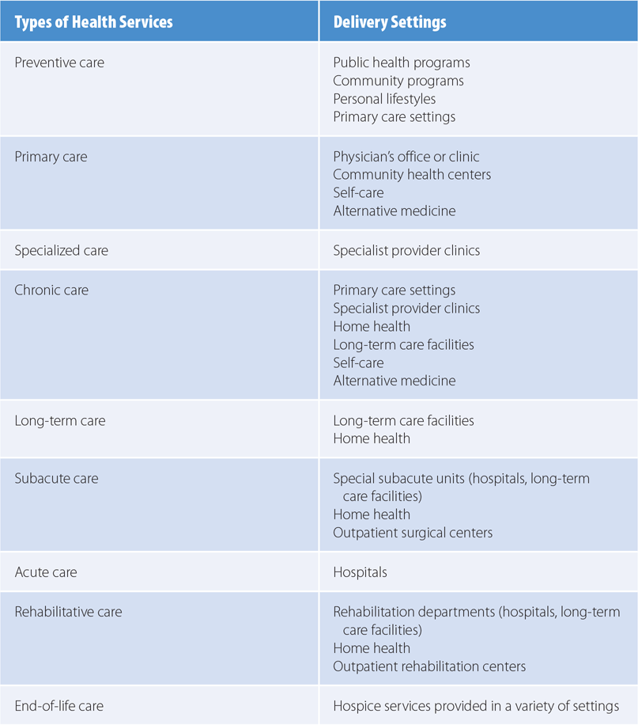
Table 1-2: The Continuum of Health Care Services

Slide 30
10. Quest for Quality
Definition and measurement are not clear-cut.
Increased pressure to develop quality standards
Demonstrate compliance
Higher expectations.
Continuous quality improvement.
Notes:
Information updated

Slide 31
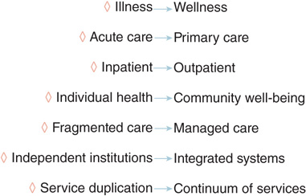
Figure 1-4: Trends and direction in health care delivery.

Slide 32
Trends and Directions
The U.S. health care delivery system continues to undergo fundamental shifts.
Promotion of health while reducing costs.
Focus is changing from illness to wellness.
Providing more effective and efficient quality care.
Focused more on delivery of services.
Mid-level health professionals, health coaches, and health information technology

Slide 33
Trends and Directions: Challenges
Managing costs
Focusing on care delivery
Adopting technologies
Delivering new operating models
Meeting various federal and state regulations

Slide 34
Significance for Health Care Practitioners
Understanding of the health care delivery system
Can attune health professionals to their relationship with the rest of the health care environment
Can help understand changes and the impact of those changes on their practice
Adaptation and relearning

Slide 35
Significance for Health Services Managers (1 of 2)
Positioning the organization
Know organization position in the macro environment
Handling threats and opportunities
Proactively deal with any threats to their institutions profitability and viability
Evaluate implications
Understand relevant issues

Slide 36
Significance for Health Services Managers (2 of 2)
Planning
Strategic planning of which services should be added or discontinued
Capturing new markets
Know emerging trends before market is overcrowded.
Complying with regulations
Following the organizational mission

Slide 37
Health Care Systems of Other Countries
Three basic models
National health insurance
Quad-function model
Financing
Insurance
Payment
Delivery
National health system
Socialized health insurance
Notes:
Information updated

Slide 38
Health Care Systems of Other Countries: Australia
Switched from a universal national health care program to a privately financed system
Returned to a national program called Medicare
Philosophy of everyone contributing to the cost of health care according to their capacity to pay
Developed health service delivery models to contain costs, and provide quality and accessible care
Developed a National Primary Health Care Strategy

Slide 39
Health Care Systems of Other Countries: Canada
Medicare consists of 13 provincial and territorial health insurance plans sharing basic coverage
Nearly all Canadian provinces (except Ontario) have resorted to regionalization
In 2004 created the 10-Year Plan to Strengthen Health Care
Transitioning to patient-centered care

Slide 40
Health Care Systems of Other Countries: China (1 of 2)
Evolved from a public insurance system (government or public enterprise) to a multipayer system.
Facing the growing problems of a large uninsured population and health care cost inflation.
Three-tier referral system has been largely abolished.

Slide 41
Health Care Systems of Other Countries: China (2 of 2)
Health reform initiatives in five major areas
Health insurance, pharmaceuticals, primary care, public health, and public/community hospitals
Establishment of an essential drug system
In 2015 announced a five-year plan

Slide 42
Health Care Systems of Other Countries: Germany and the UK
Germany
Health insurance mandatory for all citizens and permanent residents since 2009
Pharmaceutical Market Reform Act
Act to Strengthen SHI Health Care Provision
United Kingdom
National Health Service (NHS)
Better Care Fund in 2013
Five Year Forward View plan in 2014

Slide 43
Health Care Systems of Other Countries: Israel and Japan
Israel
Universal coverage based on German SHI model
Employer tax and individual income-based contributions
National health information exchange in 2014
Japan
Providing universal coverage with two main insurance schemes
Employer-based and national insurance program
Japan Primary Care Society will run a training program

Slide 44
Health Care Systems of Other Countries: Singapore
Had a British-style NHS program.
Medisave provides universal coverage.
Chronic Disease Management Program.

Slide 45
Systems Framework
System foundations
System resources
System processes
System outcomes
System outlook
Figure 1-4: Trends and direction in health care delivery.

Slide 46
Summary
The U.S. has a unique health care delivery system.
Through private and public financing
Through private health insurance and public insurance programs
Not governed by free-market principles.
No country has a perfect health care insurance system.
Health care managers must understand how the health care delivery system works and evolves.

